Slide 1
CRYSTAL STRUCTURE
A Repeating Pattern in 3 Dimensions

Slide 2
Let’s Start with One Dimension

Slide 3
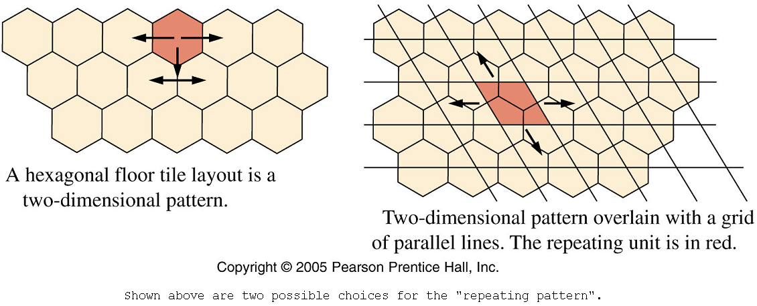
Now Let’s Try Two Dimensions

Slide 4
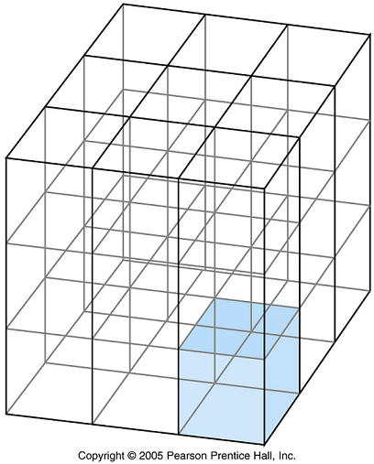
Now Consider 3 Dimensions

Slide 5
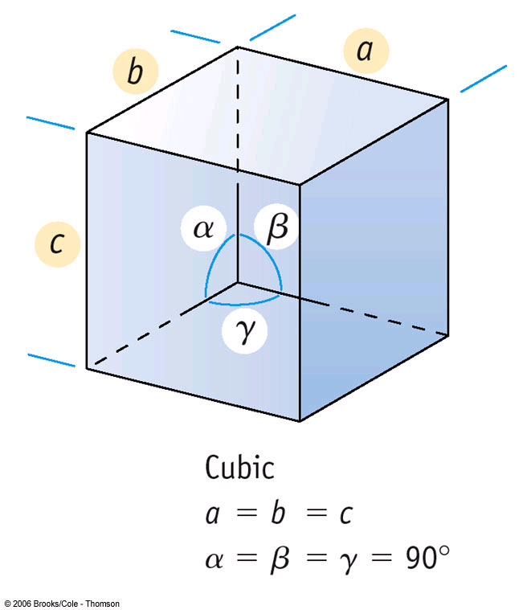
Anatomy of a Cube

Slide 6
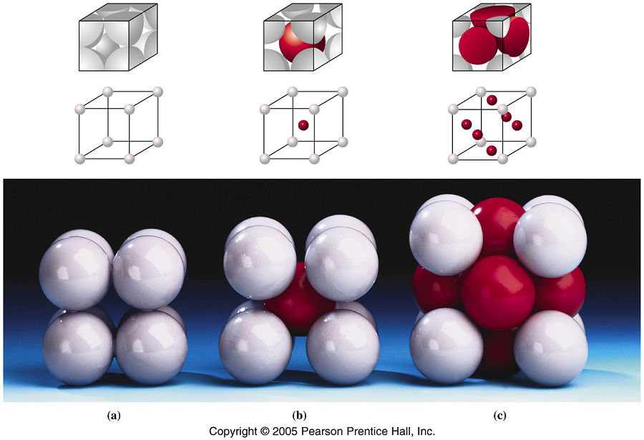
Cubic Crystal Structures

Slide 7
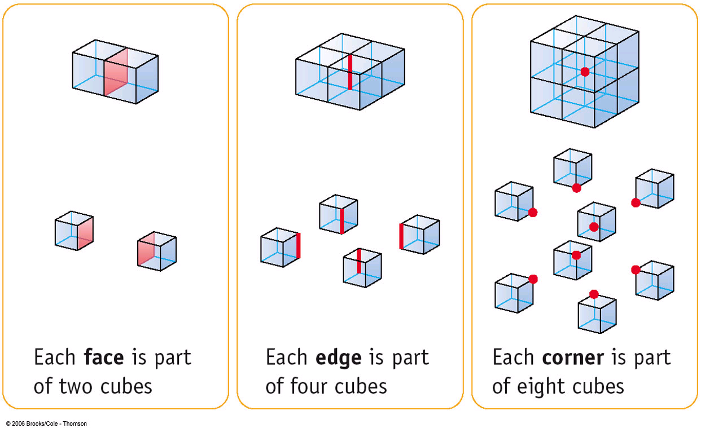
Partitioning Atoms Among Cubes

Slide 8
Now Let’s Work Some Problems!

Slide 10
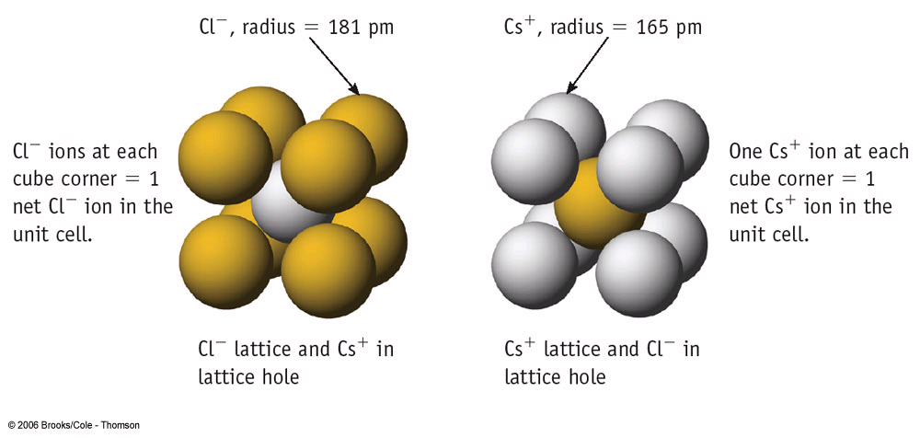
CsCl Crystal Structure

Slide 11
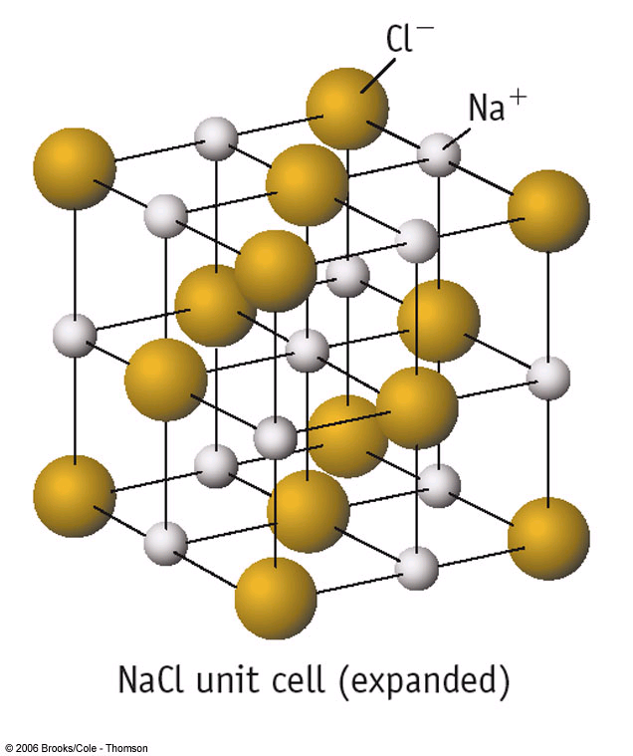
NaCl Crystal Structure

Slide 12
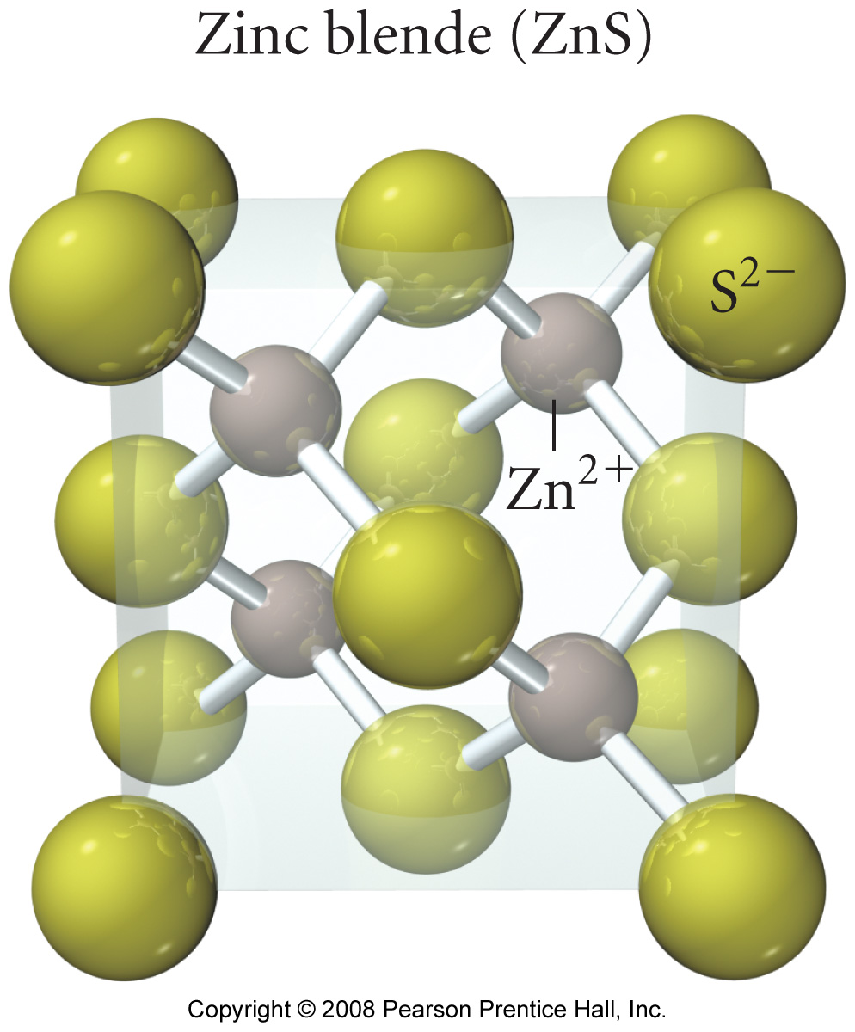
ZnS Crystal Structure

Slide 13
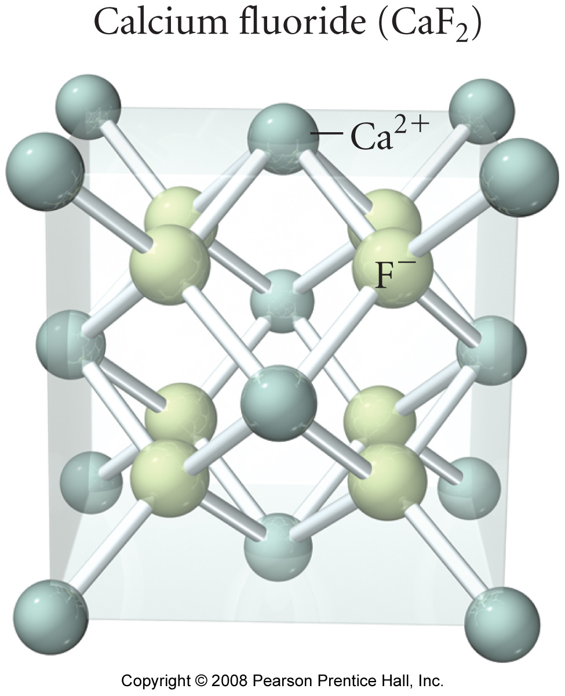
CaF₂ Crystal Structure

Slide 14
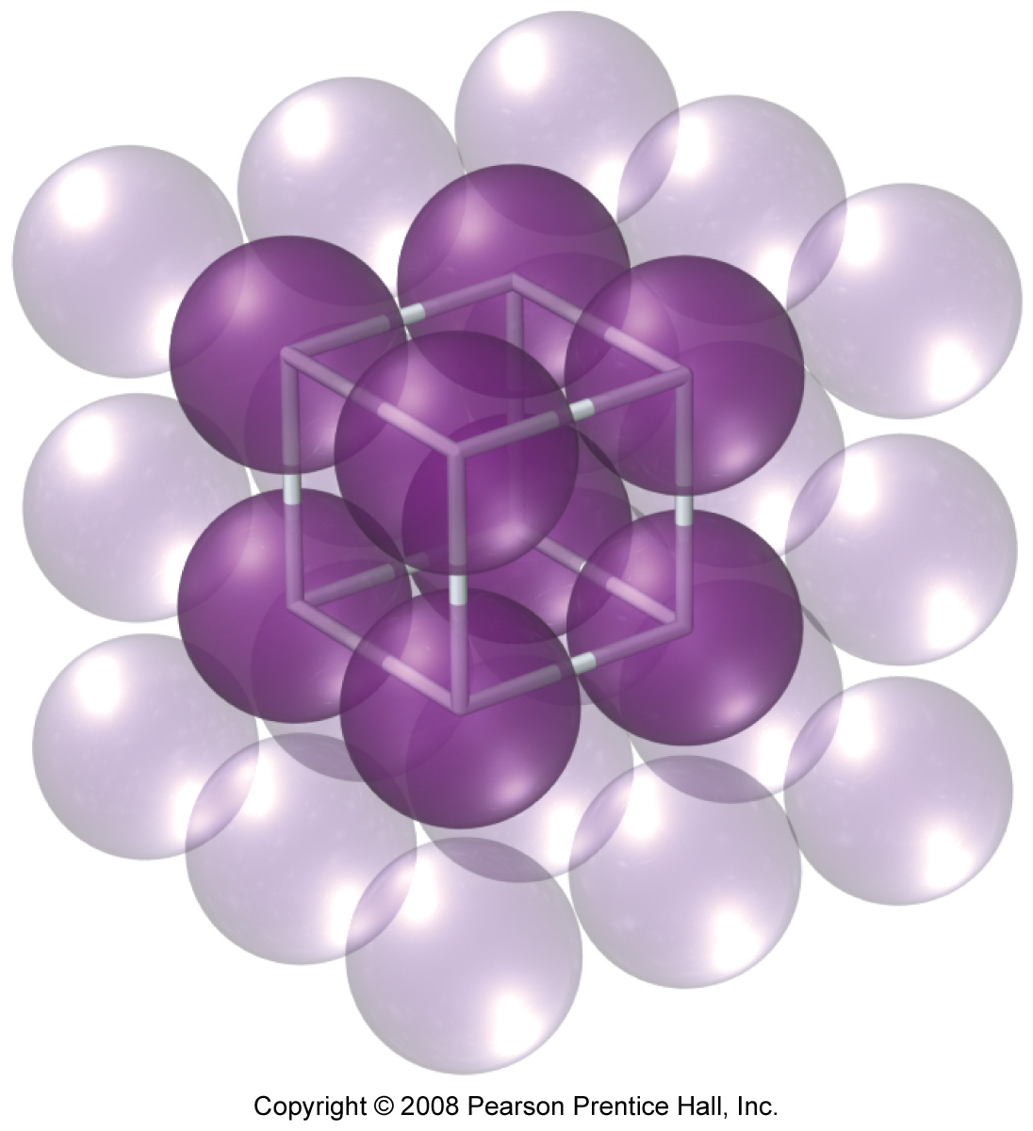
Stacking Spheres

Slide 15
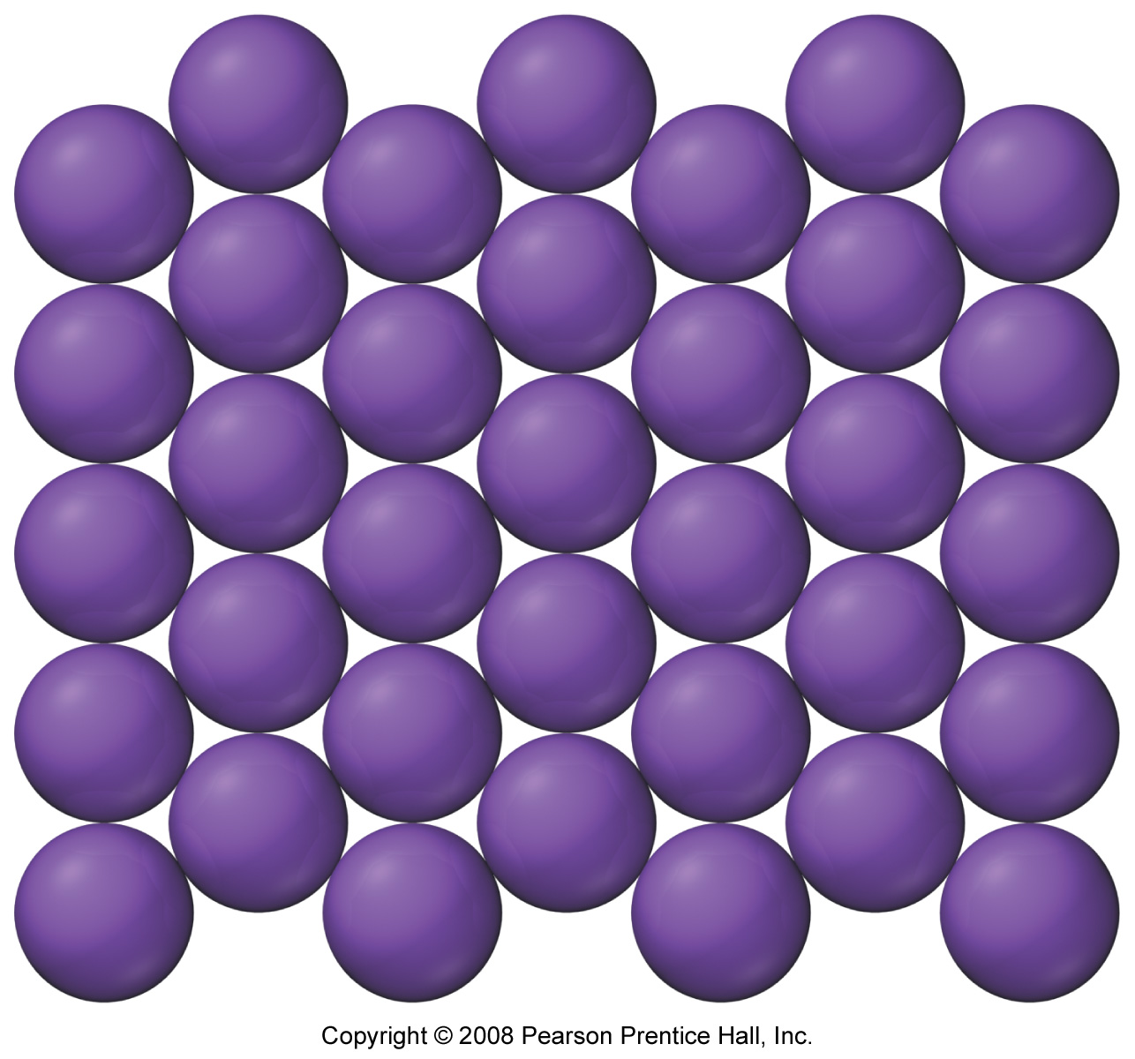
Stacking Spheres

Slide 16
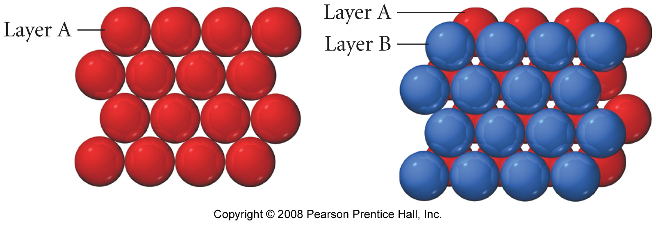
Stacking Spheres

Slide 17
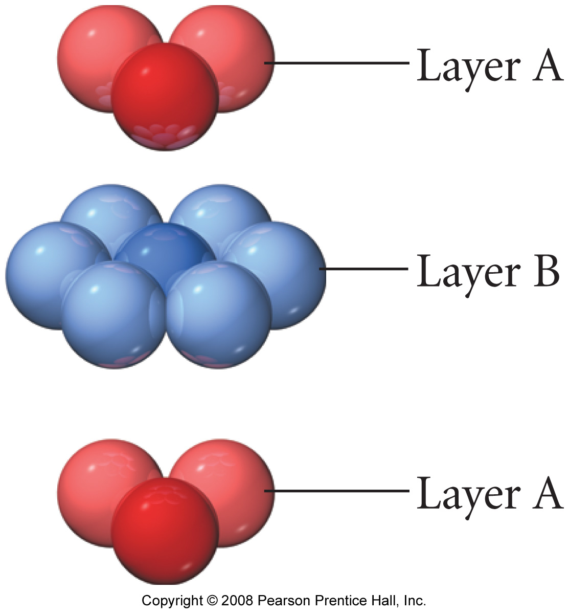
Stacking Spheres

Slide 18
Stacking Spheres

Slide 19
Stacking Spheres

Slide 20
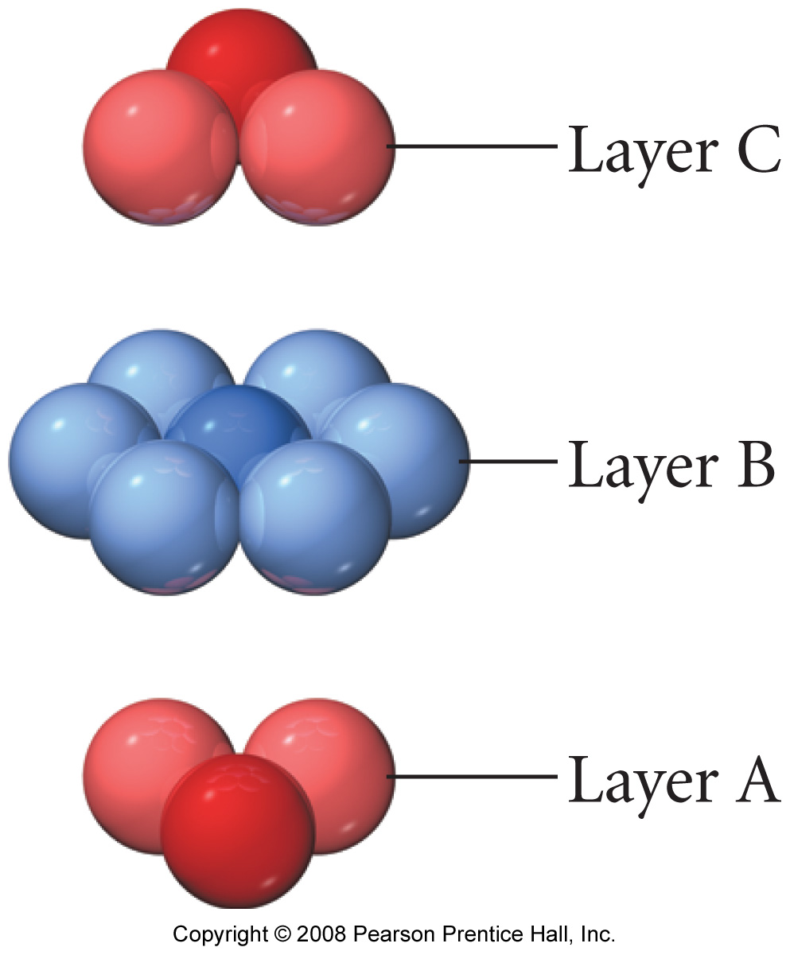
Stacking Spheres

Slide 21
Stacking Spheres

