Slide 1
Solutions
Homogeneous Mixture of 2 or more Substances

Slide 2
Some Terminology
Solvent – The substance that “does the dissolving”
Solute – The substance that “gets dissolved”
Solution – The resulting mixture

Slide 3
Why Do Solutions Form?

Slide 4
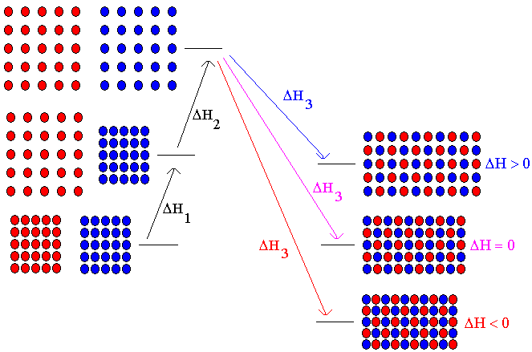
Why Isn’t Everything Soluble in Everything?

Slide 5
Some Concentration Units
Molarity - # mol solute / # L solution
Molality - # mol solute / # kg solvent
Mole Fraction of substance - # mol / total mol
Mass Percent of Solute 100% (solute mass / solution mass)

Slide 6
Time to do some calculations!
Calculation of concentration units
Conversion of one concentration unit to another

Slide 7
Colligative Properties
Vapor Pressure Lowering
Boiling Point Elevation
Freezing Point Depression
Osmotic Pressure

Slide 8
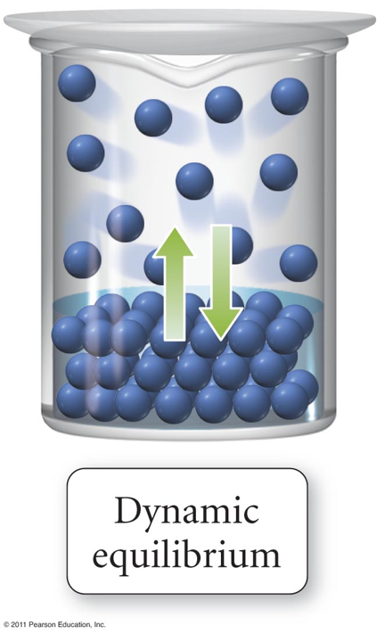
Why Does a Solute Lower Vapor Pressure?

Slide 9
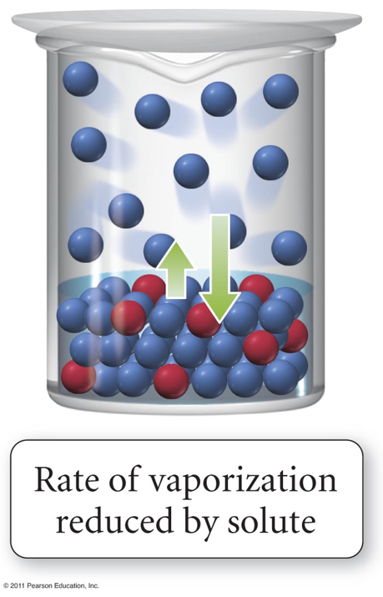
Solute Reduces Rate of Evaporation

Slide 10
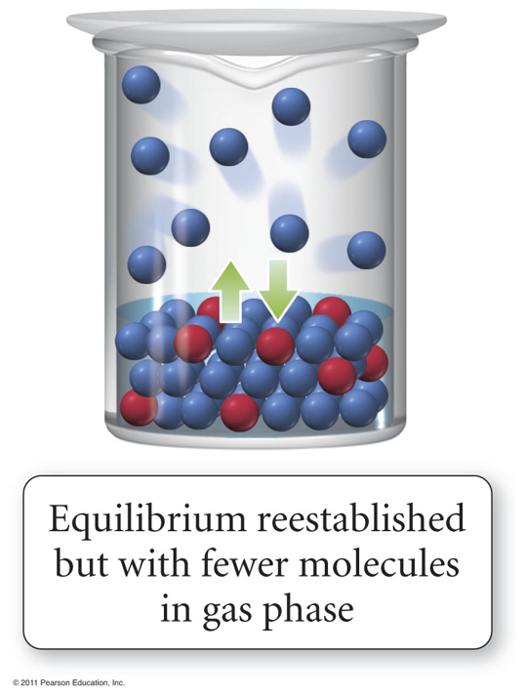
Equilibrium Reestablished at Lower Pressure

Slide 11
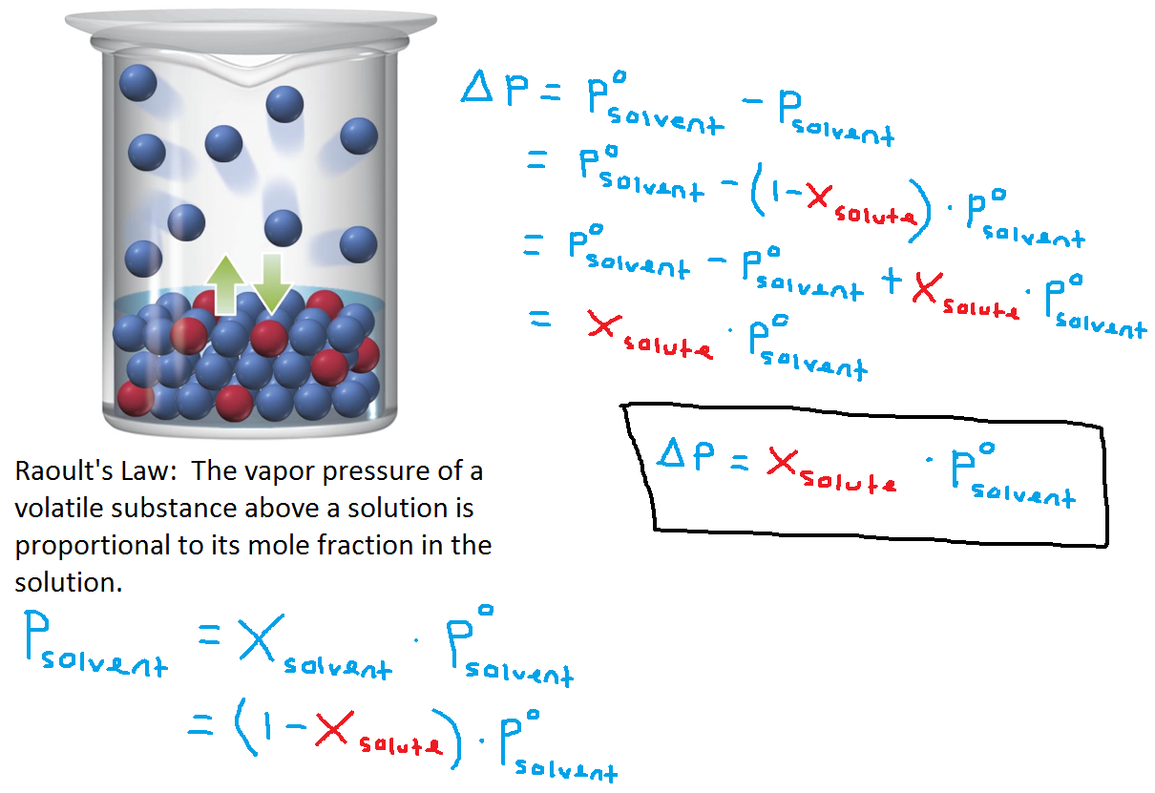
Raoult’s Law

Slide 12
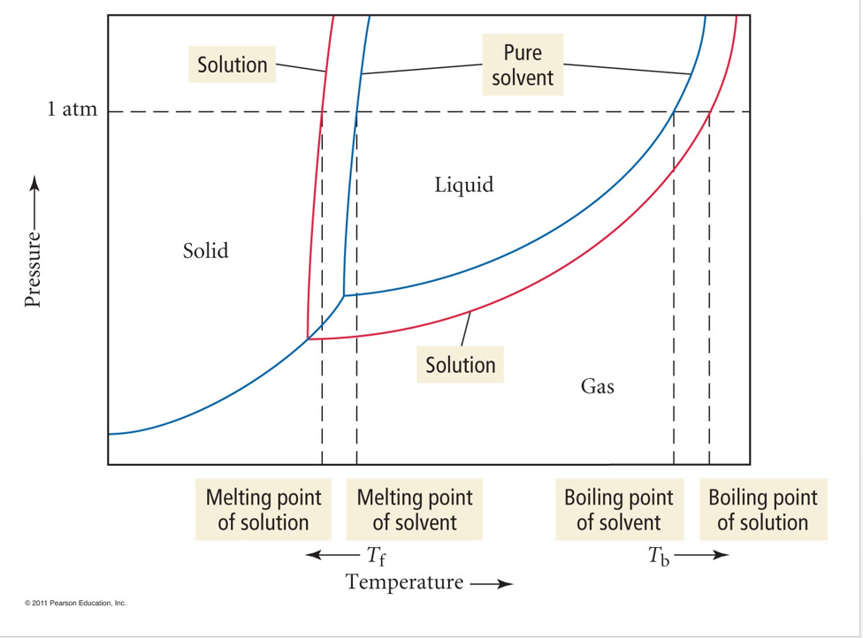
Why Does Vapor Pressure Lowering Change the Boiling and Freezing Points?

Slide 13
Raoult’s Law Applied to Two Volatile Components in a Solution

