Slide 1
Acid / Base Equilibria
A Practical Application of the Principles of Equilibrium

Slide 2
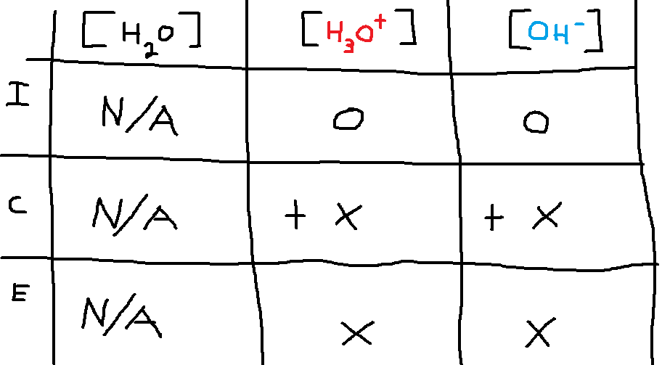
Water is always in equilibrium with its ions:
2H₂O(l) ← → H₃O⁺(aq) + OH⁻(aq)
K_{W} = [H₃O⁺] [OH⁻] = 1.0 x 10⁻¹⁴ (numeric value applies at 25 ºC)
What are the ion concentrations in pure water at equilibrium at 25 ºC?

Slide 3
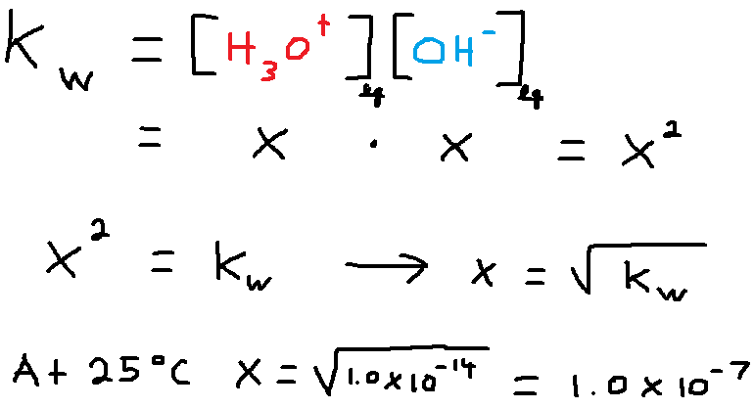
Solving the Equilibrium Equation for Water

Slide 4
The Concept of pH and pOH
pH = - log [H₃O⁺]
pOH = - log [OH⁻]
In pure water at 25 ºC, we have the following:
pH = - log (1.0 x 10⁻⁷) = 7.00
pOH = - log (1.0 x 10⁻⁷) = 7.00
Pure water is neutral in an acid / base sense, because the concentrations of H₃O⁺ and OH⁻ are equal.
At 25 ºC, a value of 7.00 is neutral on both the pH and pOH scales.

Slide 5
The Conditions in Acidic, Basic, and Neutral Solutions
Acidic: [H₃O⁺] > [OH⁻]
Basic: [OH⁻] > [H₃O⁺]
Neutral: [H₃O⁺] = [OH⁻]
ANY aqueous solution will contain BOTH H₃O⁺ ions and OH⁻ ions. Whether the solution is acidic, basic, or neutral depends on which ion (if either) predominates.

Slide 6
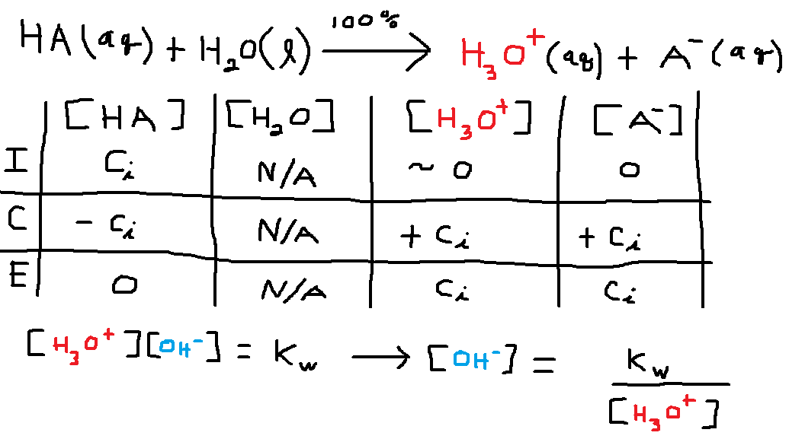
Reaction of a Strong Acid with Water

Slide 7
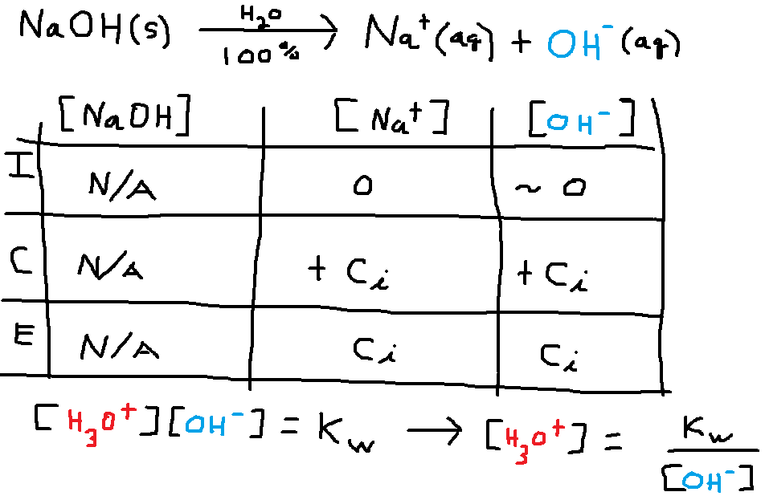
Dissolving a Water-soluble Hydroxide Compound in Water

Slide 8
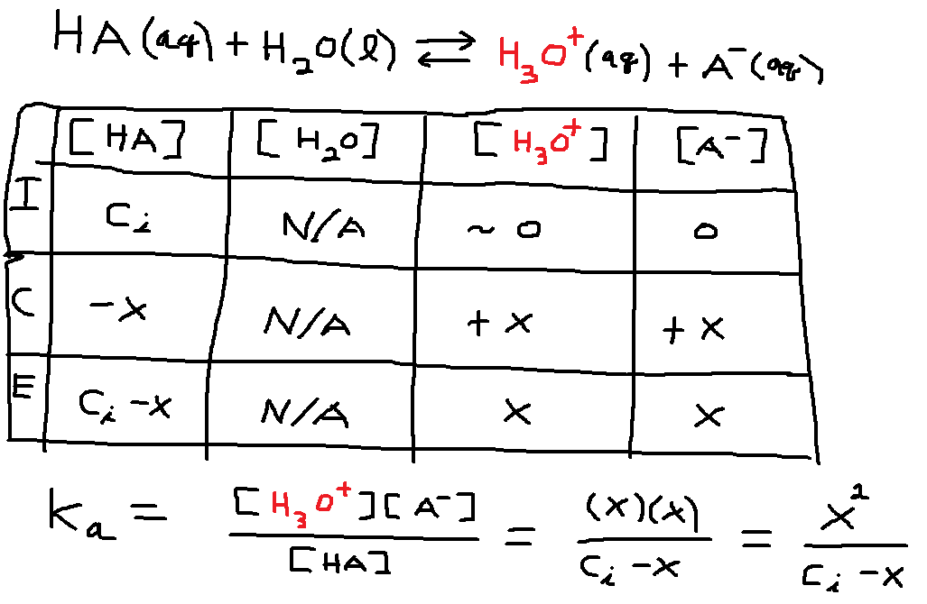
Reaction of a Weak Acid with Water

Slide 9
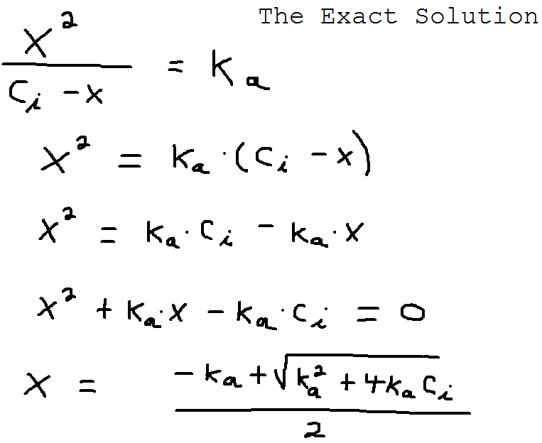

Slide 10
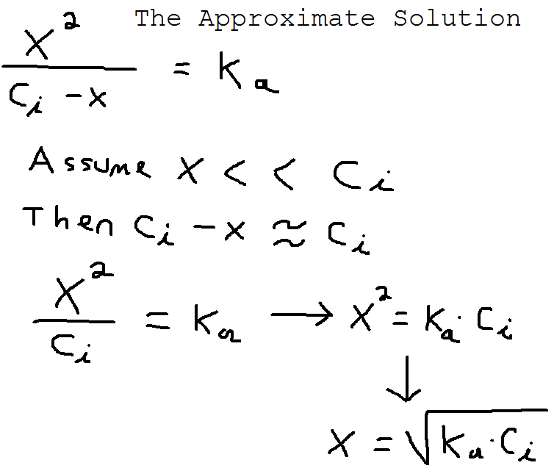

Slide 11
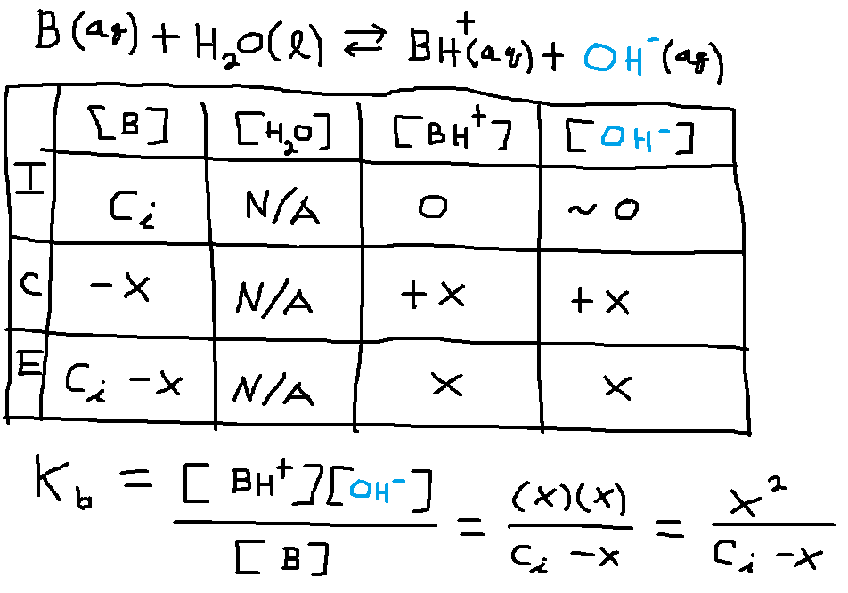
Reaction of a Weak Base with Water

Slide 12
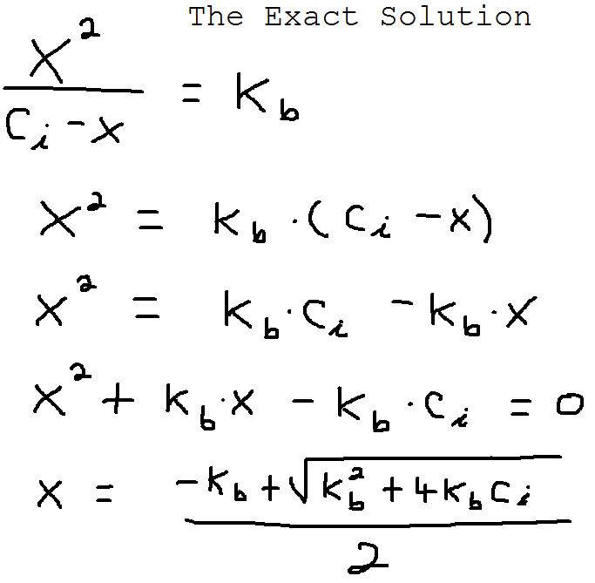

Slide 13
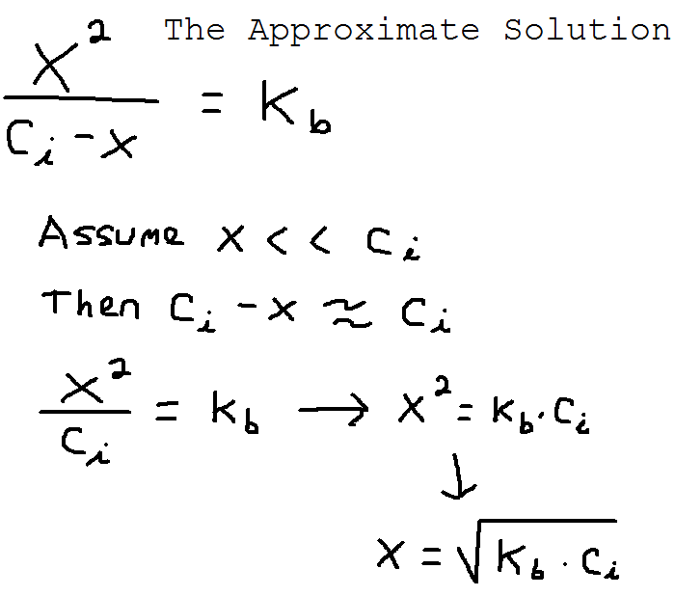

Slide 14
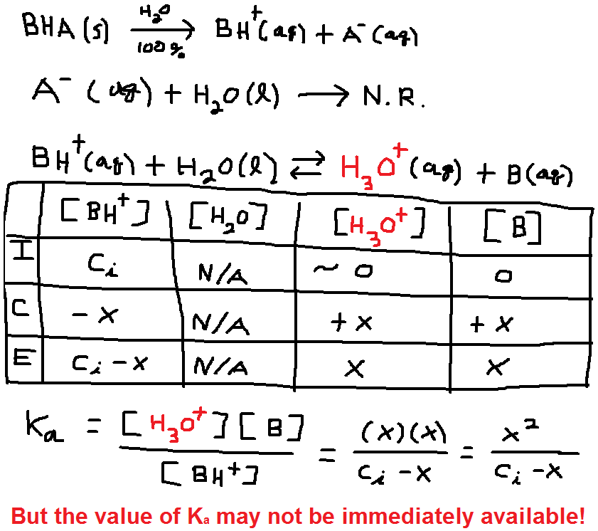
The Hydrolysis of an Acidic Salt

Slide 15
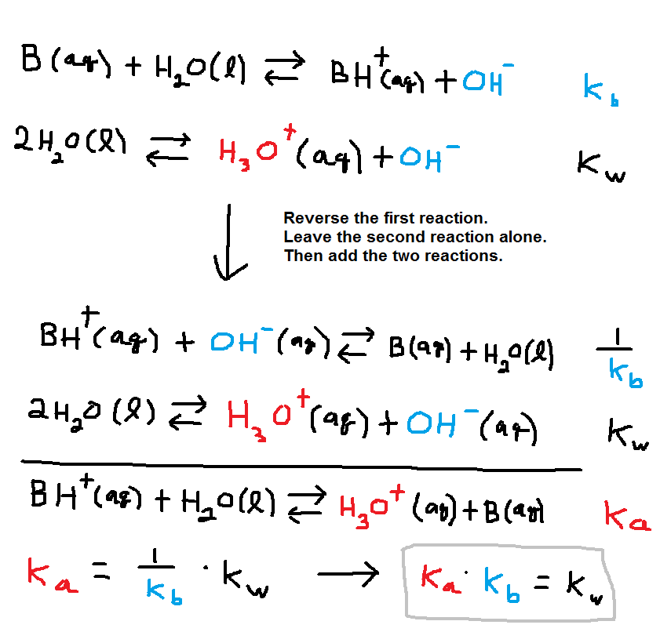
Finding the Missing K_{a} Value

Slide 16
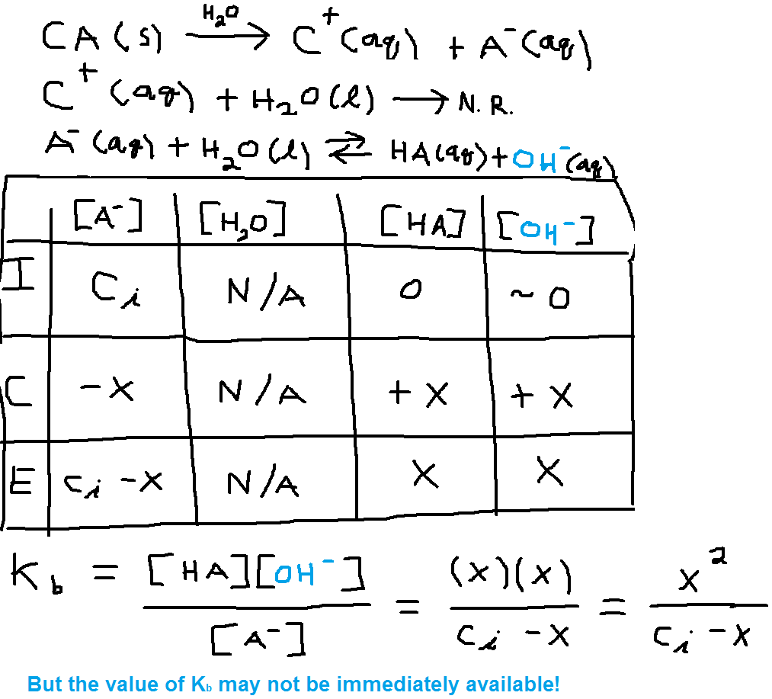
The Hydrolysis of a Basic Salt

