Slide 1
What is Chemistry?
The study of the composition, structure, and properties of matter, and the changes matter undergoes.

Slide 2
What is Matter?
Anything that has mass and occupies space.

Slide 3
How Can We Study Matter When There is So Much of It?
All of matter is made up of just a few “kinds” of matter.
People once believed that everything was made up of air, earth, fire and water.
Each “kind” of matter has a smallest possible piece that has all the properties of that “kind” of matter.

Slide 4
How Can We Study Matter When There is So Much of It?
Today, we call those “kinds” of matter elements.
The smallest piece of an element that has the properties of that element is an atom.

Slide 5
Matter can be . . .
A mixture
A kind of matter that can be separated into two or more other kinds of matter by physical processes.
A substance
A kind of matter that can not be separated into other kinds of matter by physical processes.

Slide 6
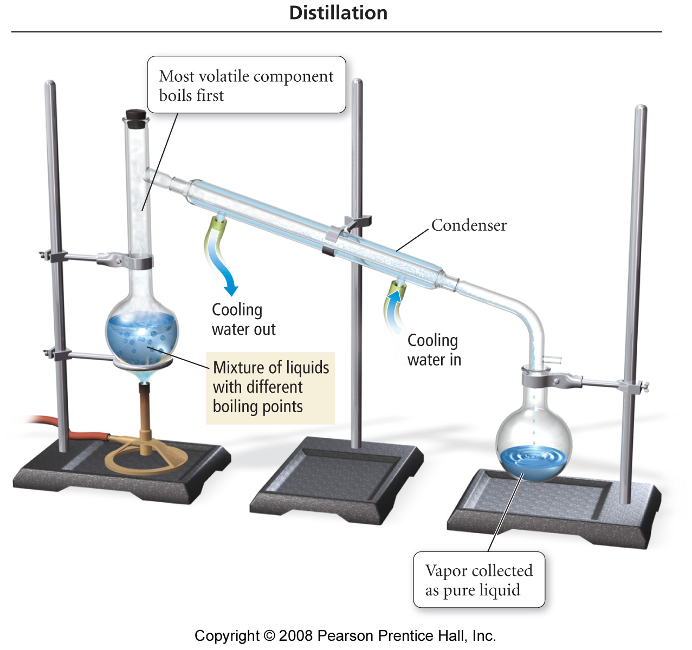
Separation of a Homogeneous Mixture

Slide 7
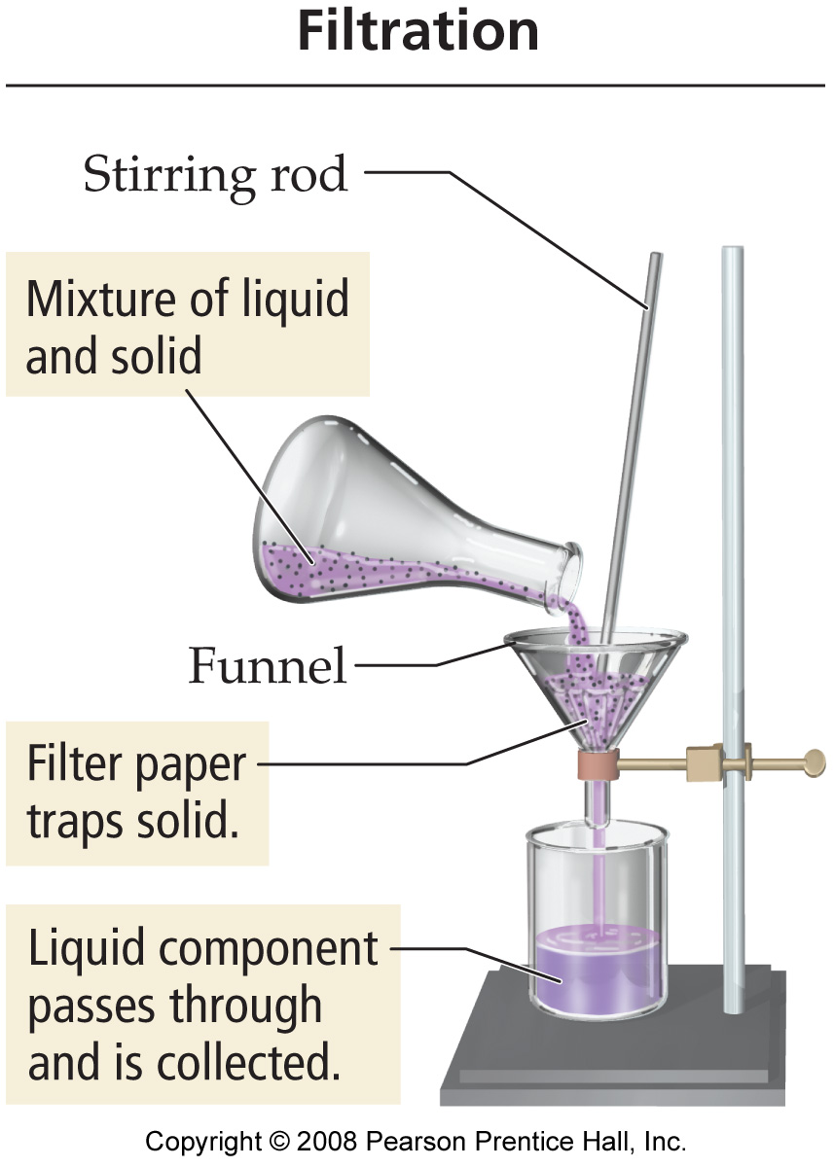
Separation of a Heterogeneous Mixture

Slide 8
When a Mixture is Separated . . .
There is no change in the chemical identity of any of its components (substances).
We take advantage of differences in physical properties to achieve the separation.

Slide 9
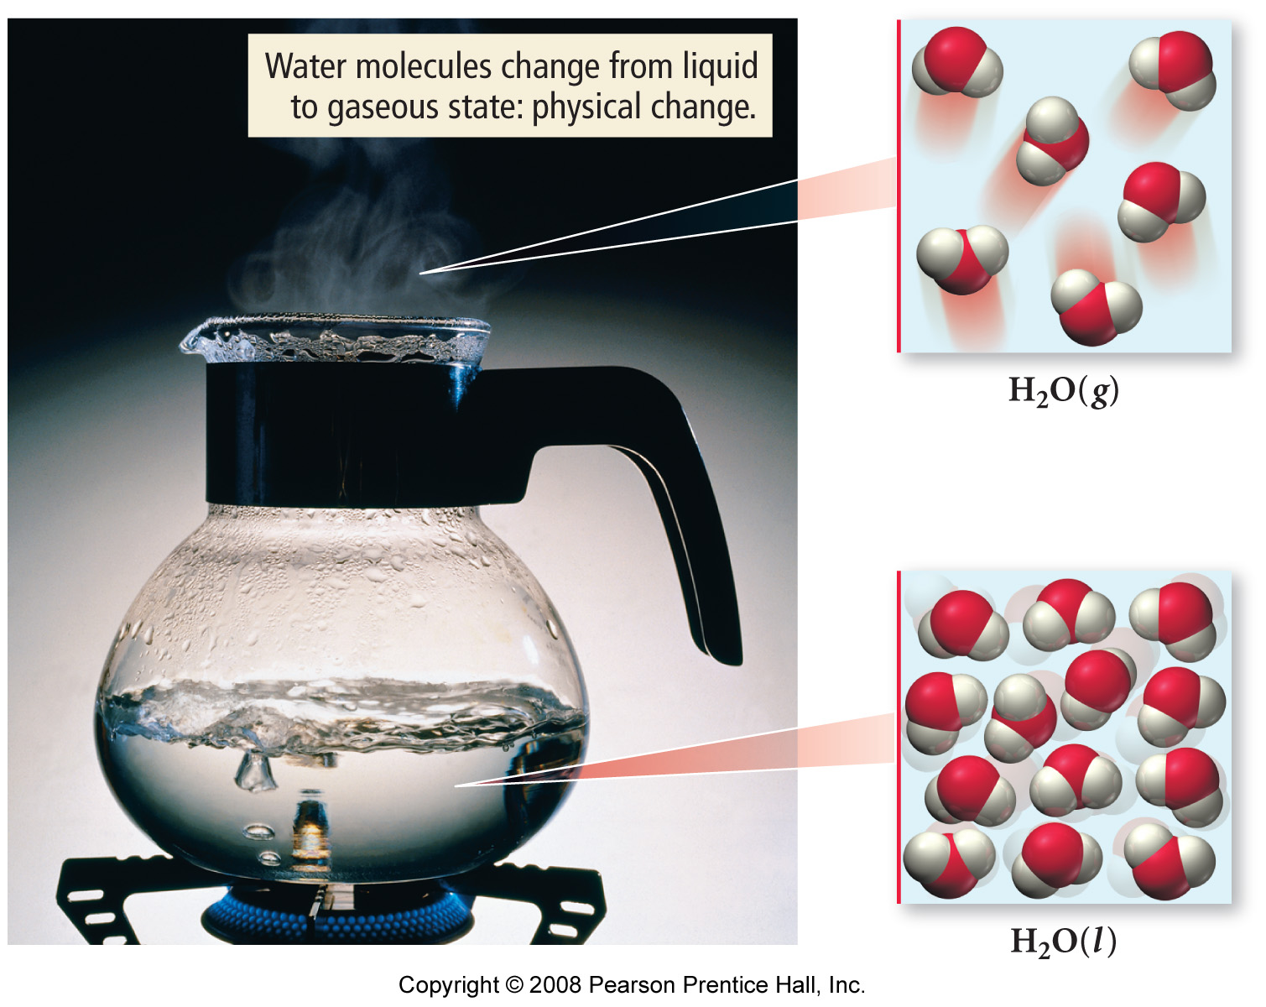
Example of a Physical Change

Slide 10
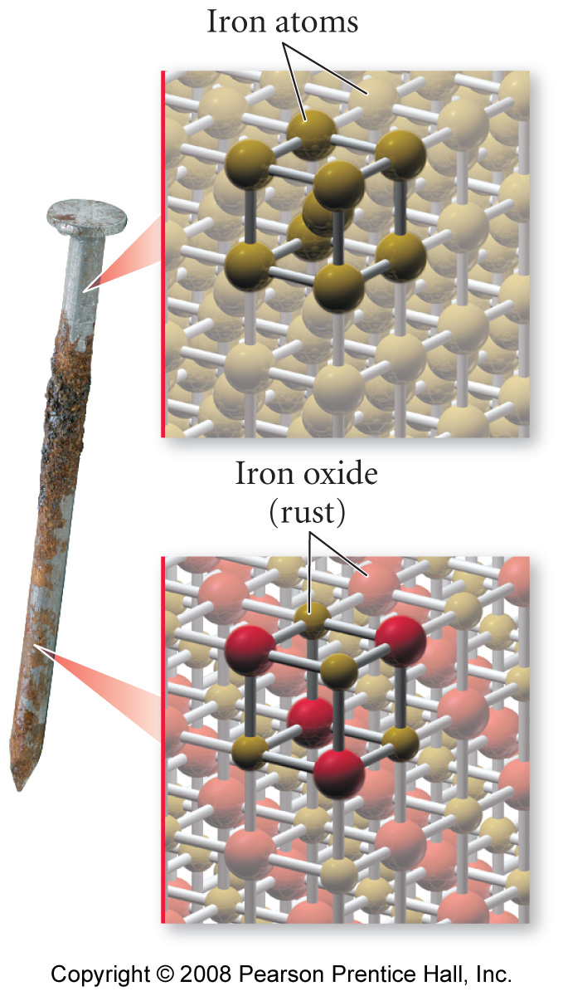
Example of a Chemical Change

Slide 11
Mixtures vs. Compounds
A mixture can have a variable composition but a compound has a fixed composition.
Example: H₂O is 11.19% H, 88.81% O
When a mixture is formed, the individual substances retain their properties, but when a compound is formed, the elements lose their properties.

Slide 12
Evidence for the Atomic Theory
Law of Definite Proportions
Law of Multiple Proportions
Law of Conservation of Mass

Slide 13
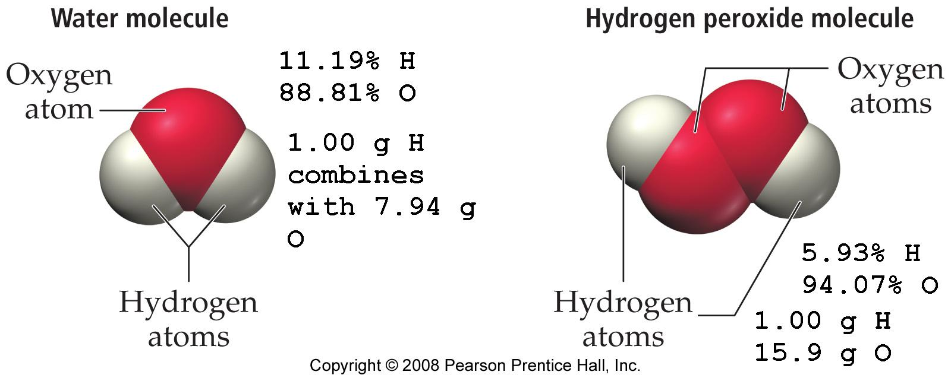
Definite / Multiple Proportions

Slide 14
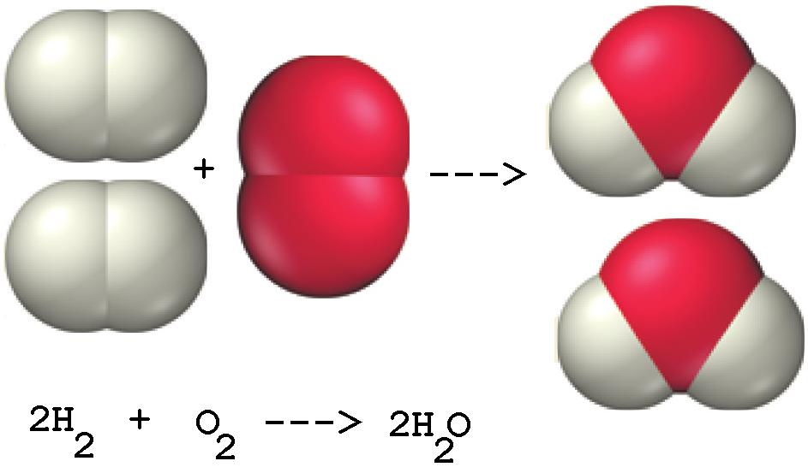
Conservation of Mass

Slide 15
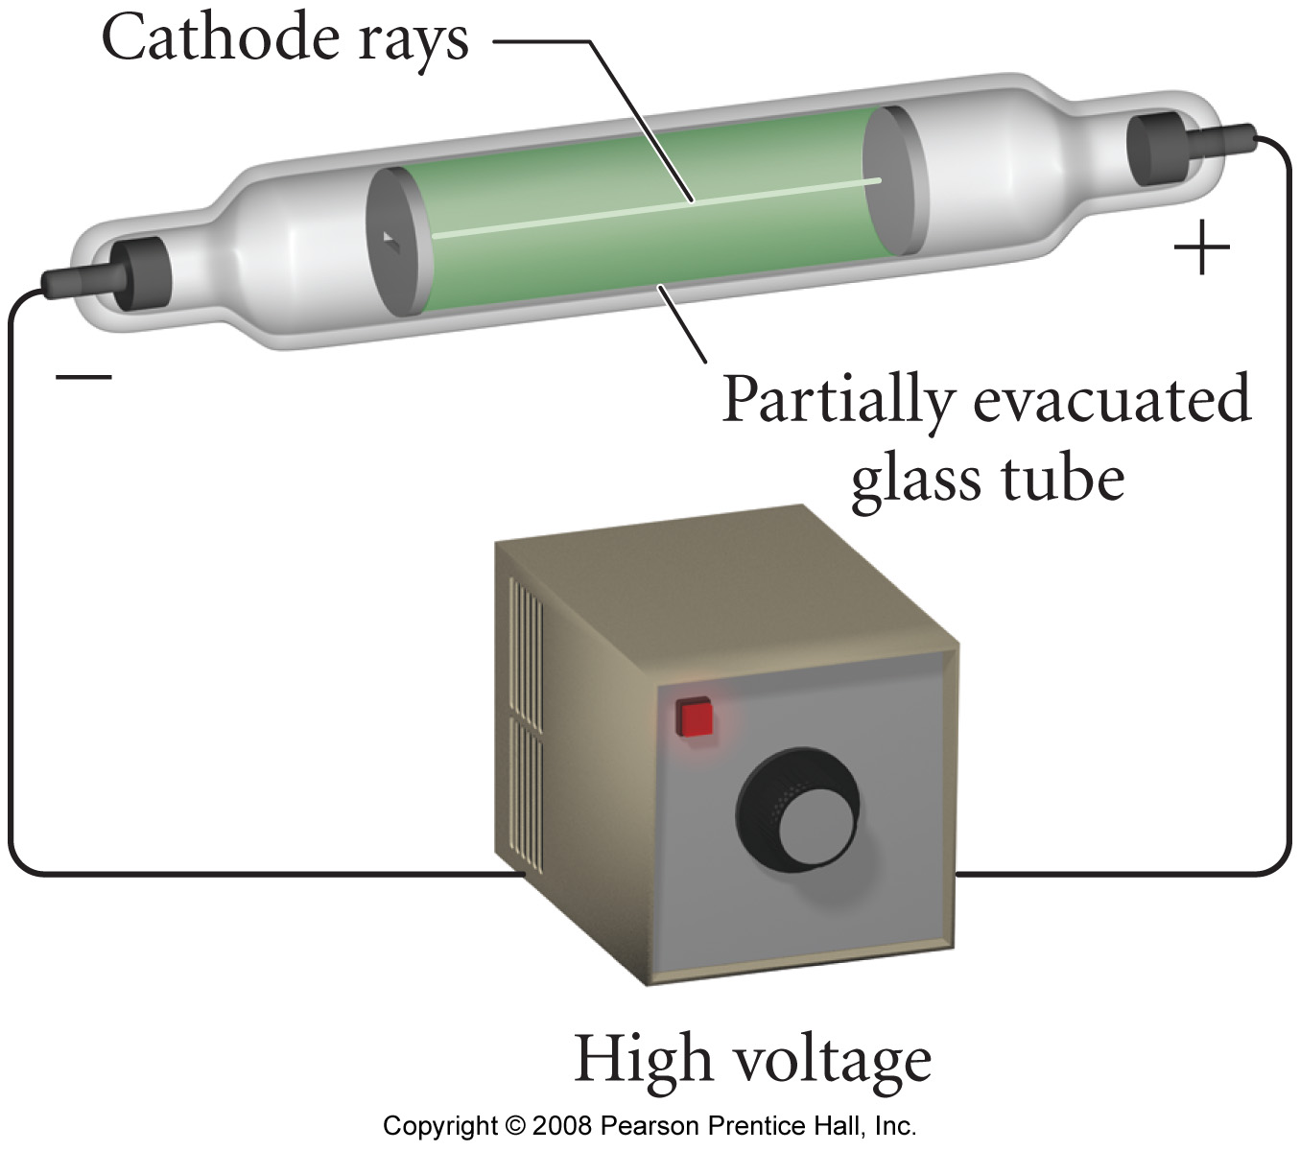
Discovery of the Electron

Slide 16
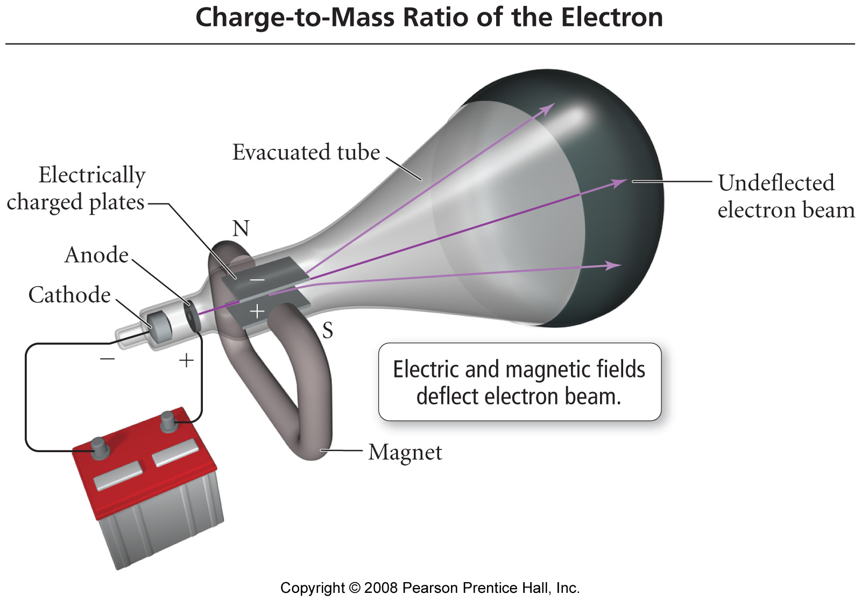

Slide 17
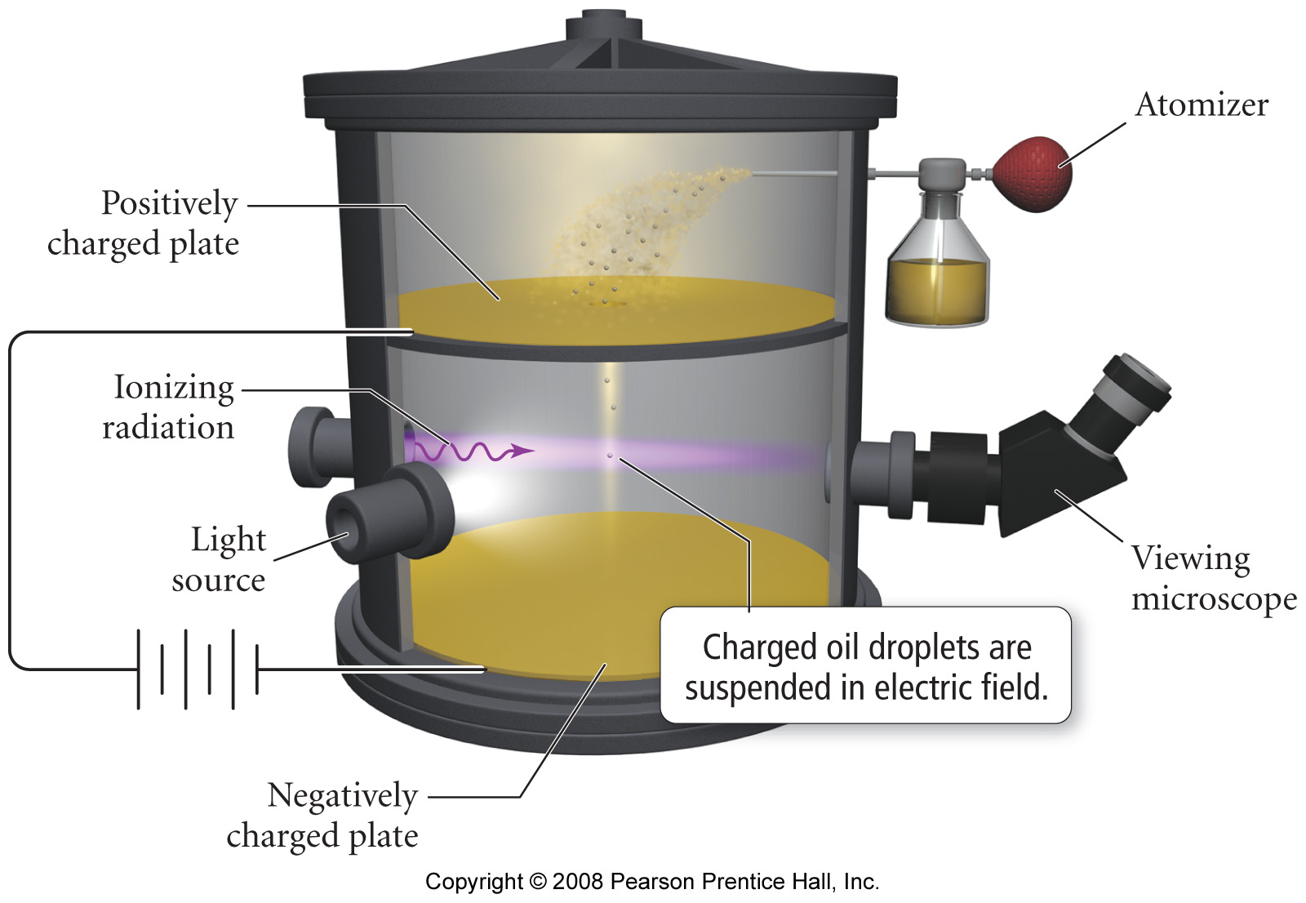
Charge of the Electron

Slide 18
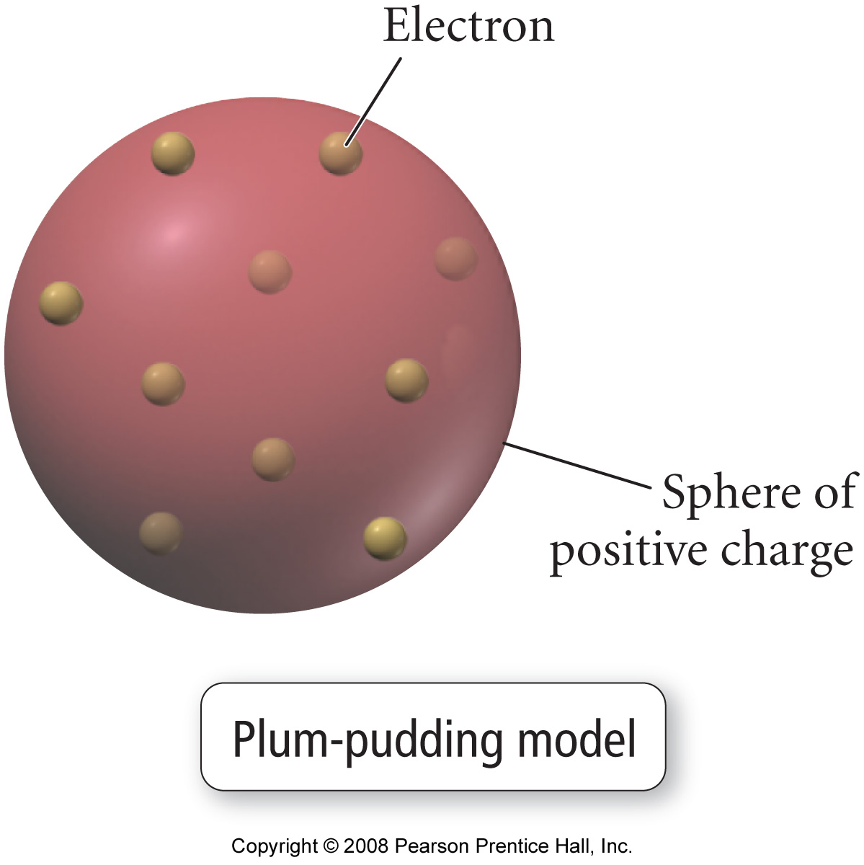
Plum Pudding Atom

Slide 19
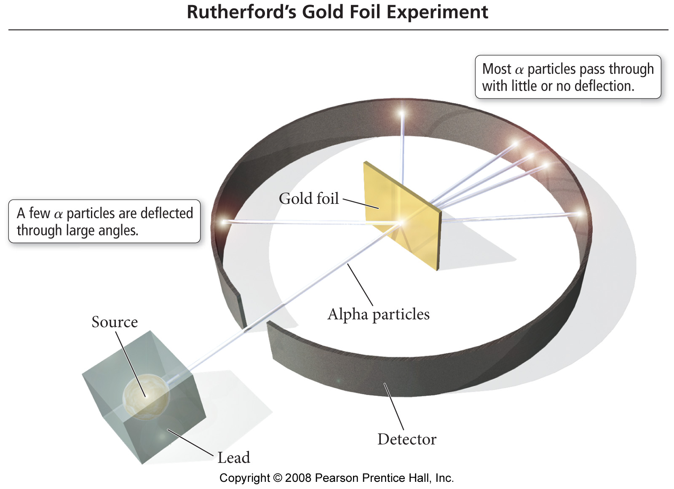
A Test of the “Plum-Pudding Hypothesis”

Slide 20
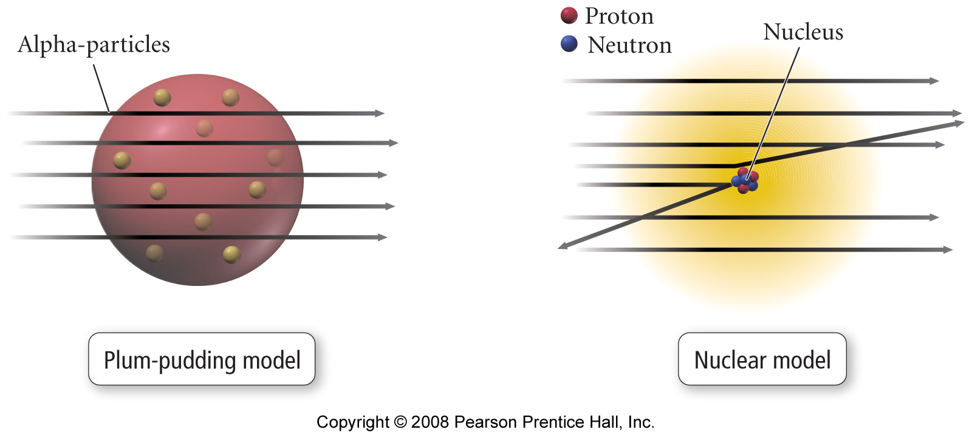
Nuclear Model of the Atom

Slide 23
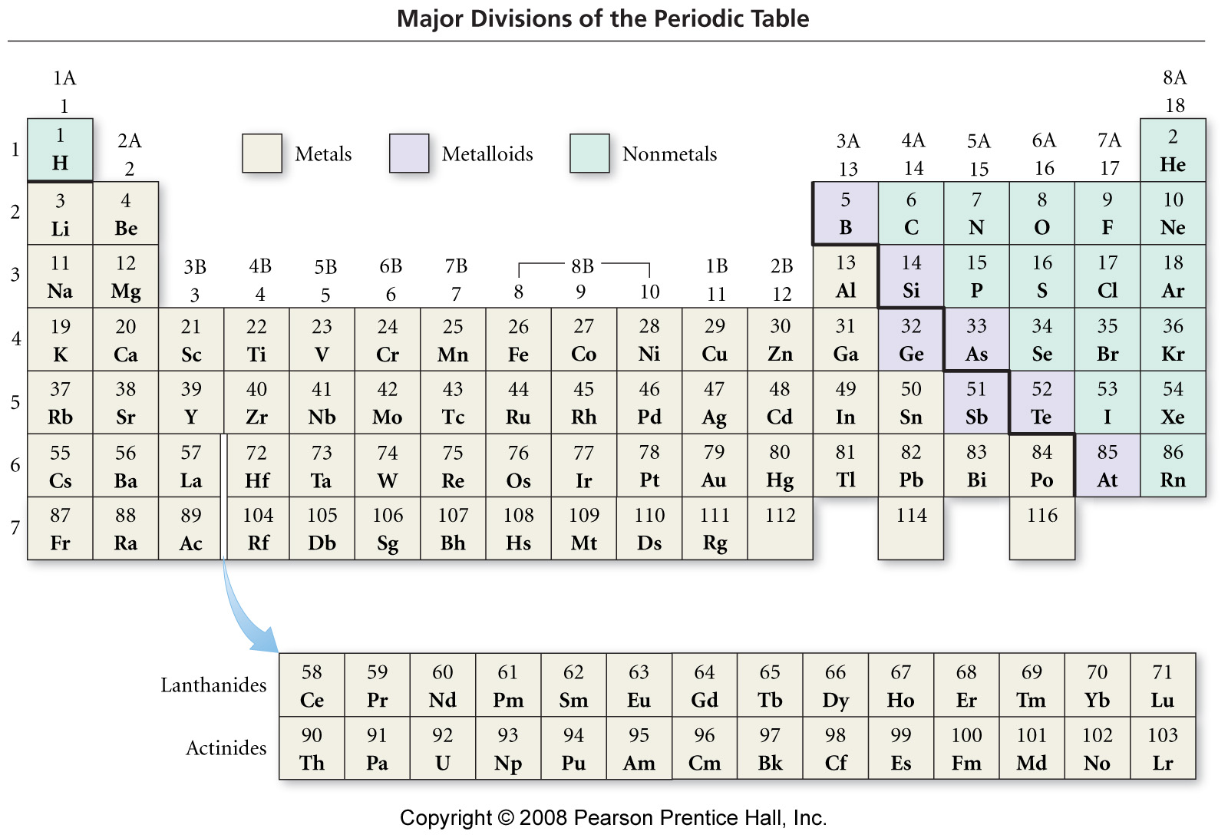

Slide 24
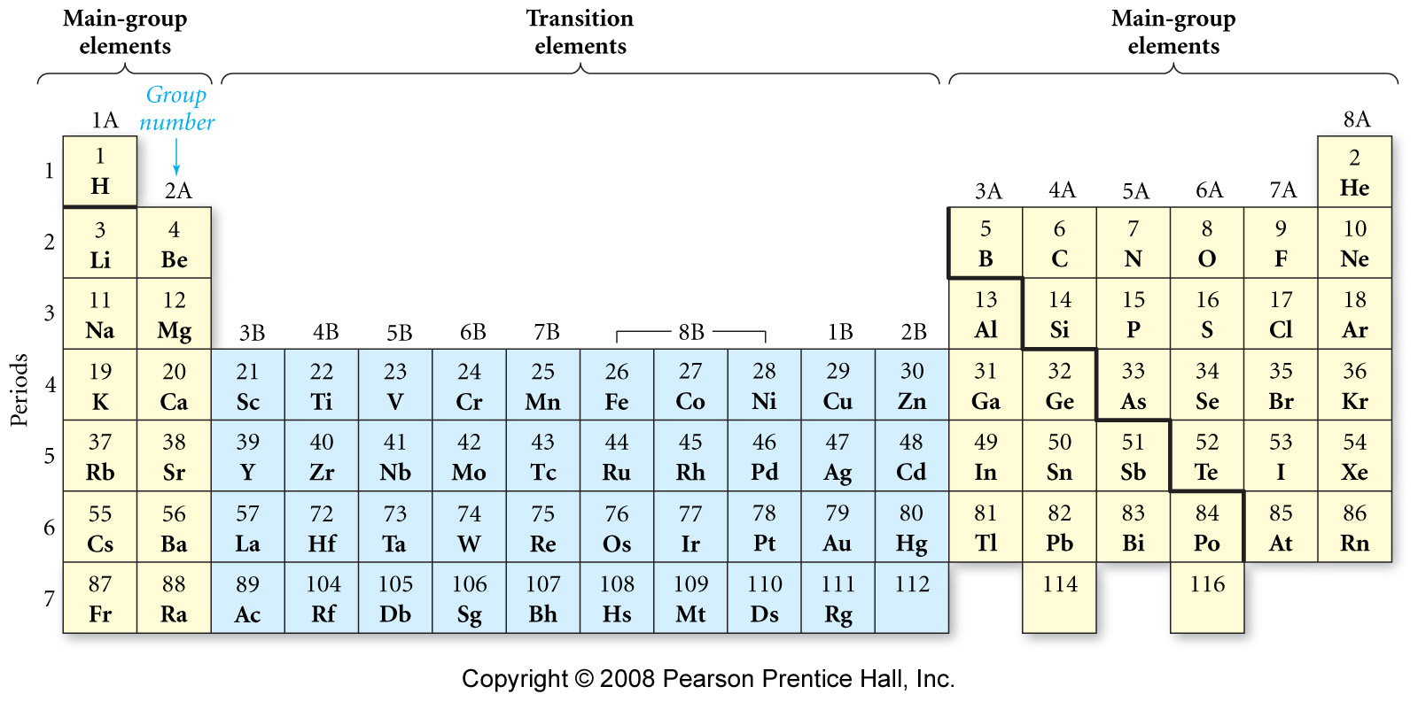

Slide 25
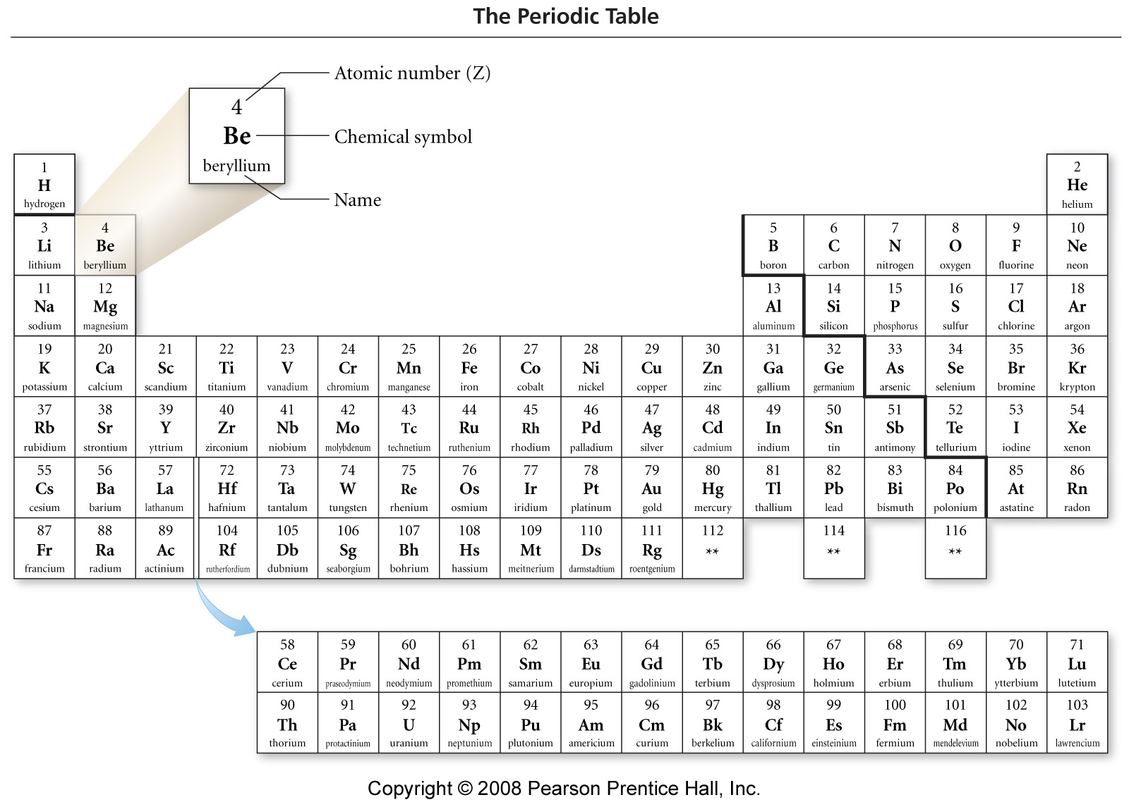

Slide 26
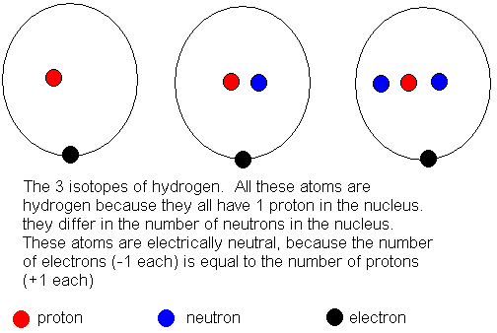

Slide 27
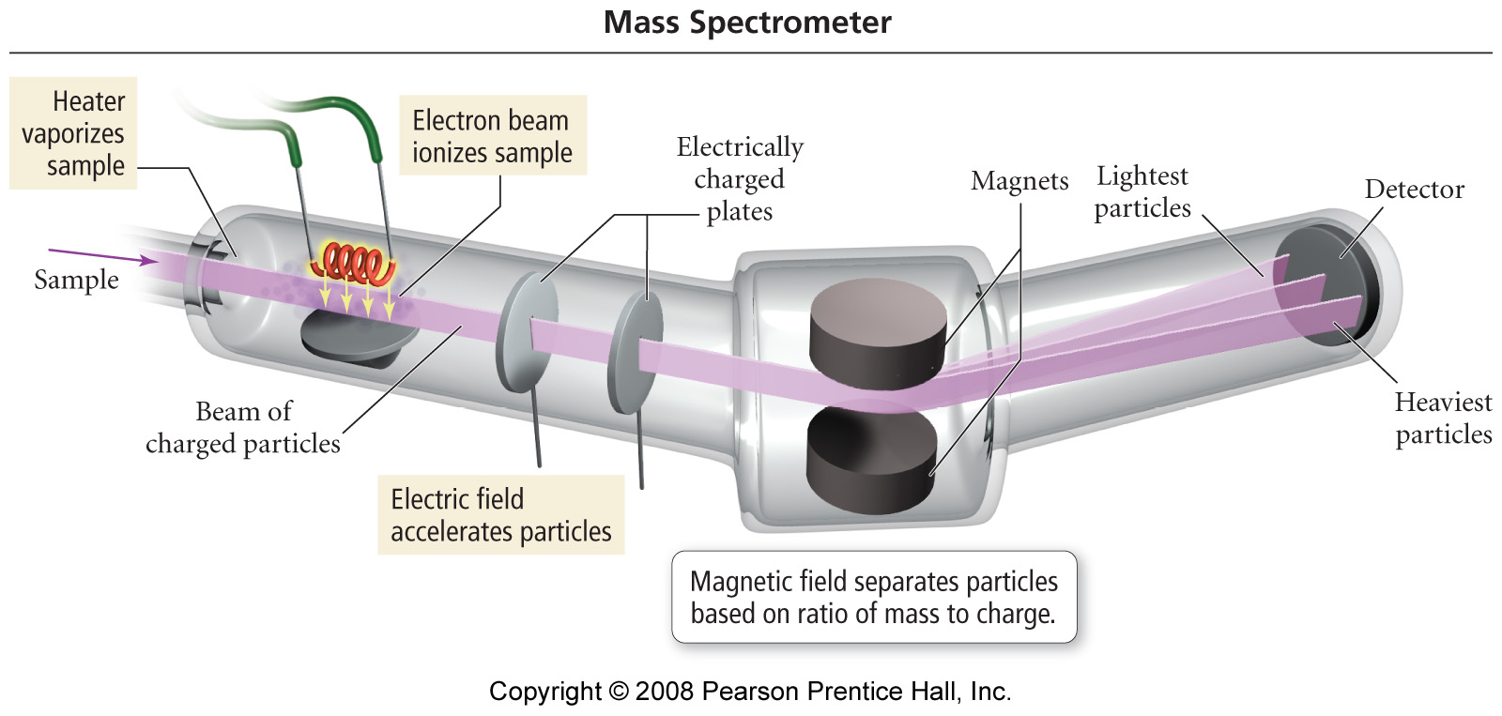

Slide 30
